Slide 1
DHEC Restructuring: Affects on Tobacco Prevention and Control, Partners and Stakeholders

Slide 2
As of July 1, 2024, SC DHEC will cease to exist
The Department of Health and Environmental Control will be split into 2 separate agencies:
Department of Public Health
Department of Environmental Services
Both agencies will become part of the Governor’s Cabinet
Previously was under the leadership of a Board of Directors, appointed by the Governor and state legislature

Slide 3
The New Department of Public Health
Includes
Health Promotion and Services
Healthcare Quality
Administration
The Division of Tobacco Prevention and Control will be part of Health Promotion Services, and will become the
Tobacco Prevention and Control Section

Slide 4
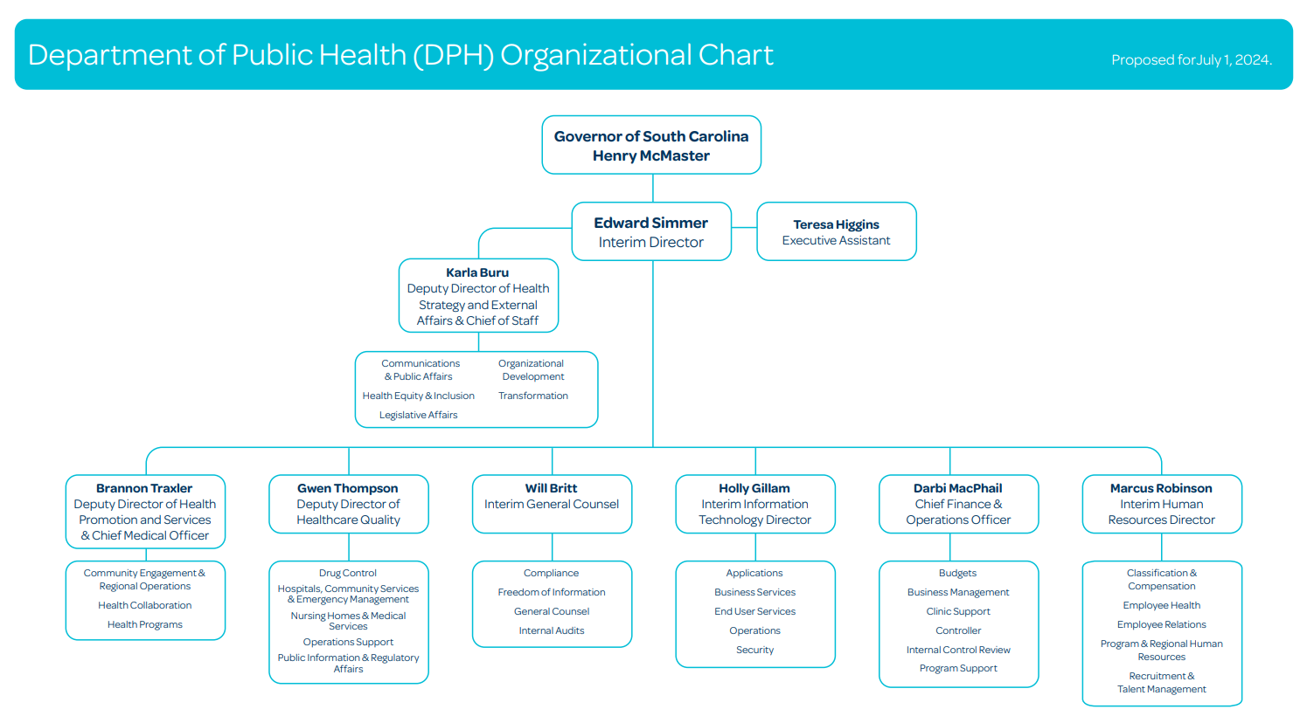

Slide 5
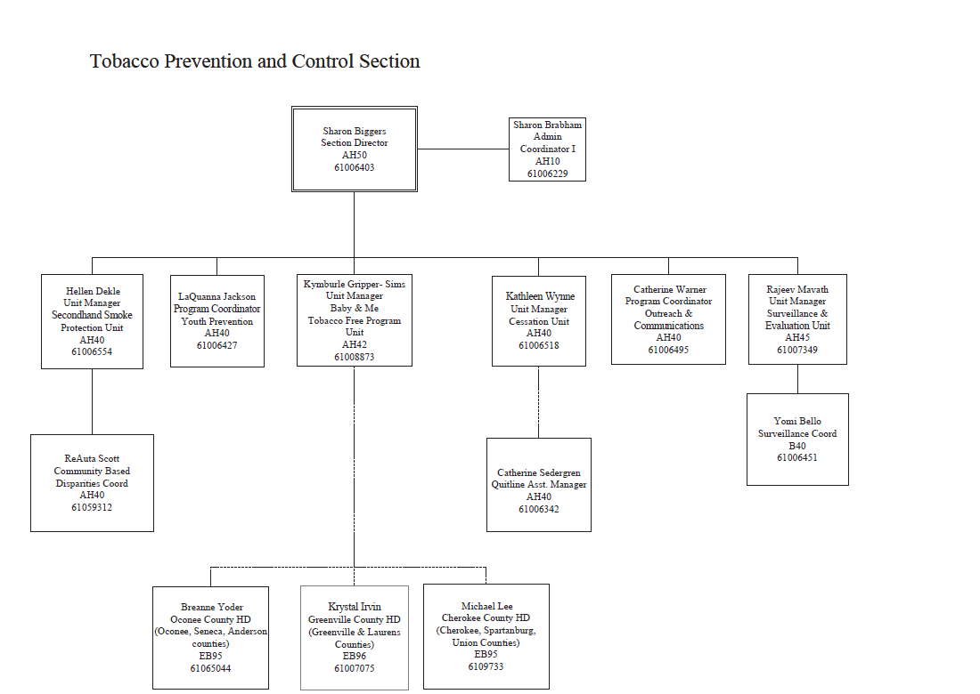

Slide 6
What changes should contractors and other partners expect to see?
No major ones really at this point
Contract numbers and internal coding will change, but all agreements in place at the time of the agency split will be maintained and carry over into the new Department of Public Health
The Cooperative Agreement with the Office on Smoking and Health at CDC remains unchanged
The TPCS will continue to receive the $5 million allocation from the Smoking Prevention and Cessation Trust fund to support efforts

Slide 7
What changes should contractors and other partners expect to see?
However, staff email address will change as of July 1:
Name@dph.sc.gov – You will see our new addresses on our staff email signatures
And all public health staff have been moved to the Mills/Jarrett (2100 Bull Street) or Columbia Mills Building (301 Gervais Street)
Environmental Health staff are now housed at 2600 Bull Street
Vital Records Office will remain where it is at 2600 Bull Street

Slide 8
Prevention and Cessation Trust Fund
Efforts include
SC Tobacco Quitline
Youth Prevention Campaign with Rescue Agency
Baby and Me Tobacco Free
Program media efforts
Contracts with partners
*Smokefree SC *TelASK, Inc.
*Hold Out the Lifeline *SC Department of Mental Health and DAODAS
*Just Say Something *SC High School League
*University of South Carolina *SC Independent School Association
*PASOs *DHEC Health Regions
*Research Triangle Institute

Slide 9
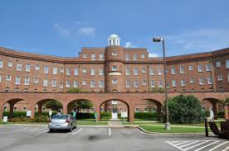
What Could Be Coming in the Future
Potential move of offices, though not resolved—Early 2025
Potential joining of DPH with other agencies (6) focusing on health—DMH, DAODAS, DDSN, DHHS, and Office on Aging

Slide 10
Contact Us
Sharon Biggers, MPH, CHES
Director
Tobacco Prevention and Control Section
Biggersr@dph.sc.gov
(803) 898-2286

